Slide 1

Vaccination Rates
Prepared by:
Veena Kottoor
Sorai Gonzales
Heather Bivona
Melissa Roman

Slide 2
What is a vaccine?
Vaccination is one of the most effective ways to prevent diseases.
A vaccine helps the body’s immune system to recognize and fight pathogens like viruses or bacteria, which then keeps us safe from the diseases they cause.
Vaccines protect against more than 25 debilitating or life-threatening diseases, including measles, polio, tetanus, diphtheria, meningitis, influenza, tetanus, typhoid and cervical cancer.
Currently, the majority of children receive their vaccines on time. However, nearly 20 million worldwide still miss out – putting them at risk of serious diseases, death, disability and ill health.

Slide 3
Measles facts:
Measles is a highly contagious viral disease that mainly affects children.
It is transmitted via droplets from the nose, mouth or throat of infected persons.
The majority of people who got measles were unvaccinated.
All the major MEASLES outbreaks in USA are linked to travelers who brought the virus back to the US from countries with ongoing outbreaks, including Ukraine, the Philippines, and Israel.
The last measles death in the United States occurred in 2015.

Slide 4
Polio facts:
Polio mainly affects children under 5 years of age.
Today, only 3 countries in the world have never stopped transmission of polio (Pakistan, Afghanistan and Nigeria)
There is no cure for polio, it can only be prevented.
Up to 95% of polio cases show no symptoms.

Slide 5
Database
Sources
CDC (Centers for Disease Control and Prevention)
WHO (World Health Organization)
Four CSV files
Measle Vaccination Rates in Certain Countries
Measle Cases in Certain Countries
Polio Vaccination Rates in Certain Countries
Polio Cases in Certain Countries
Data Cleaning
Postgres Sql

Slide 6
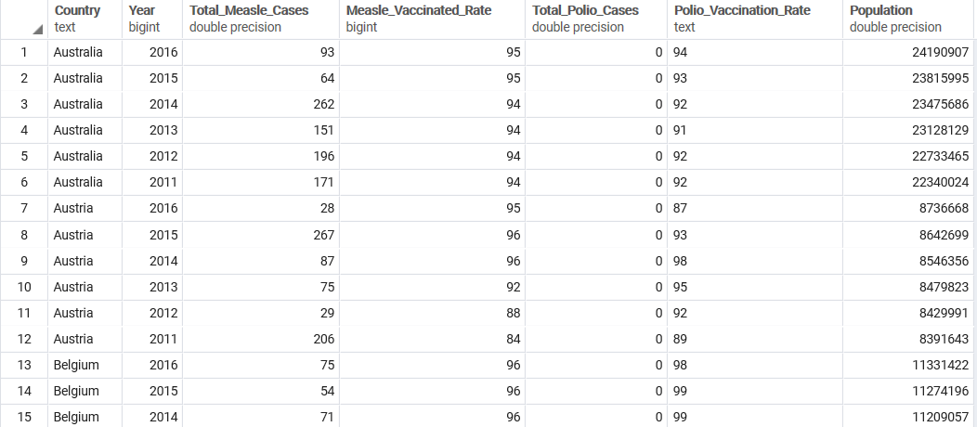
Database
38 Countries
2011 - 2016

Slide 7
Countries Years
North America: United States of America
South America: Brazil
Europe: Austria
Asia: China
Asia: India
2011
2012
2013
2014
2015
2016

Slide 8
MEASLES DATA ANALYSIS
MEASLES VACCINATION RATE & NUMBER OF CASES

Slide 9
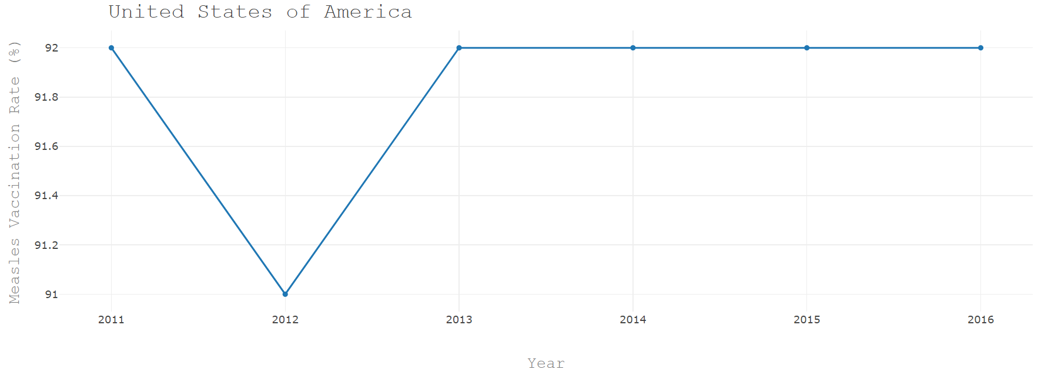
Measle Vaccinated Rate in USA

Slide 10
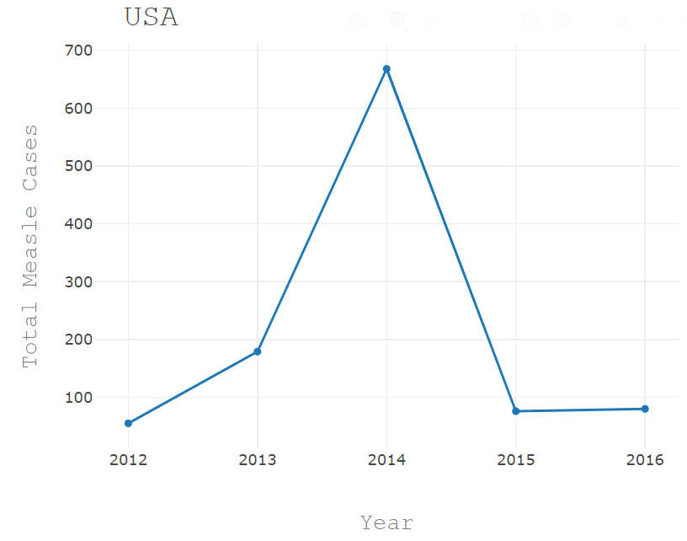
Measle Cases in USA

Slide 11
BRAZIL
MEASLES VACCINATION RATE & NUMBER OF CASES

Slide 12
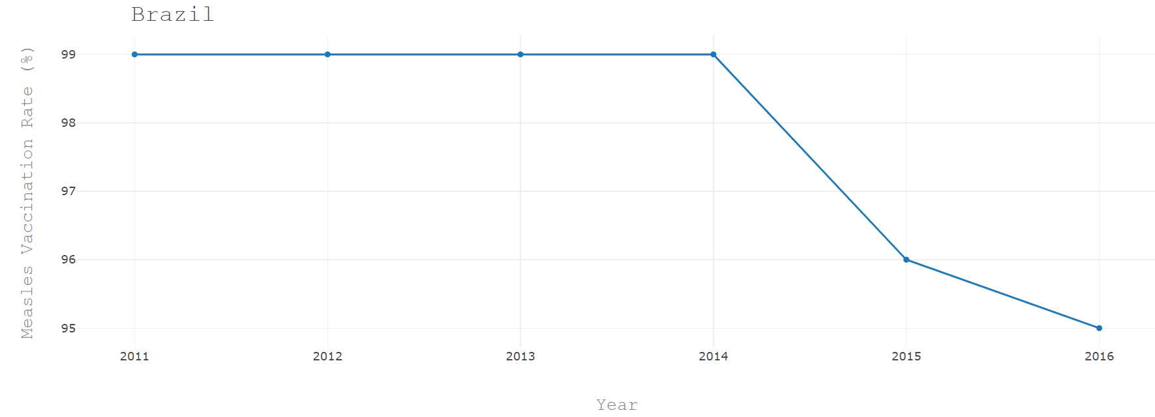
Measle Vaccinated Rate in Brazil

Slide 13
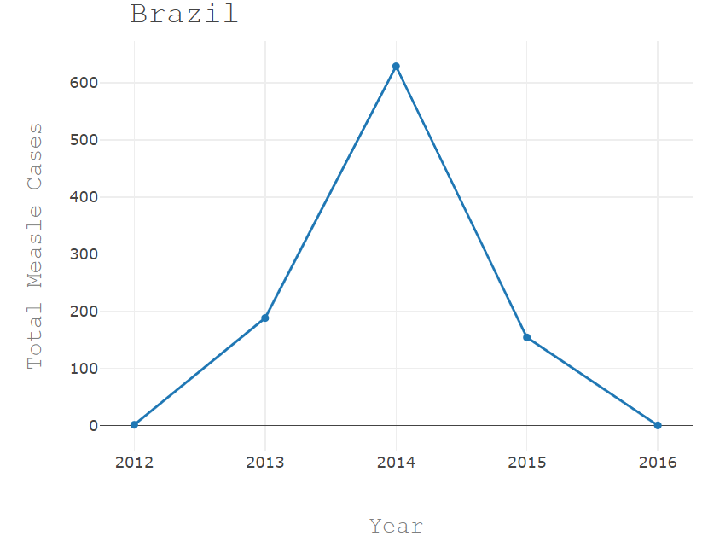
Measle Cases in Brazil

Slide 14
AUSTRIA
MEASLES VACCINATION RATE & NUMBER OF CASES

Slide 15
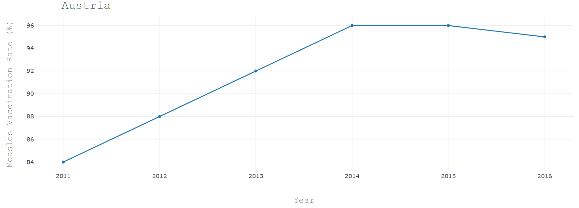
Measle Vaccinated Rate in Austria

Slide 16
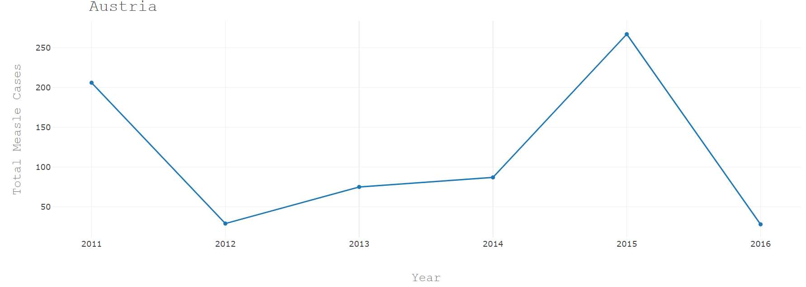
Measle Cases in Austria

Slide 17
CHINA
MEASLES VACCINATION RATE & NUMBER OF CASES

Slide 18
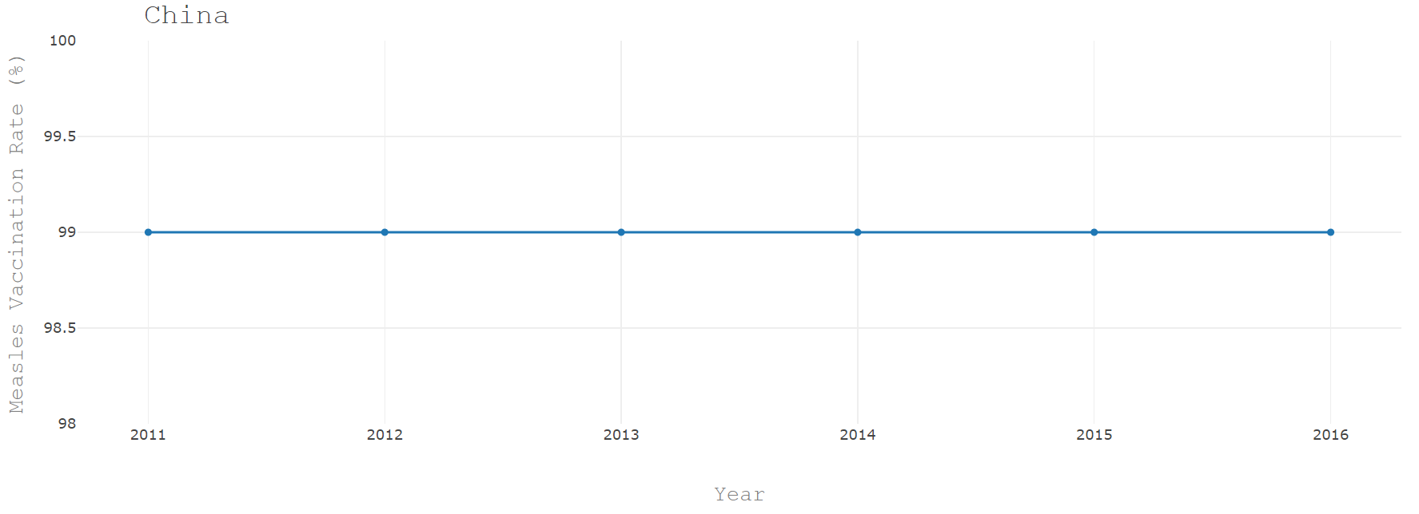
Measle Vaccinated Rate in China

Slide 19
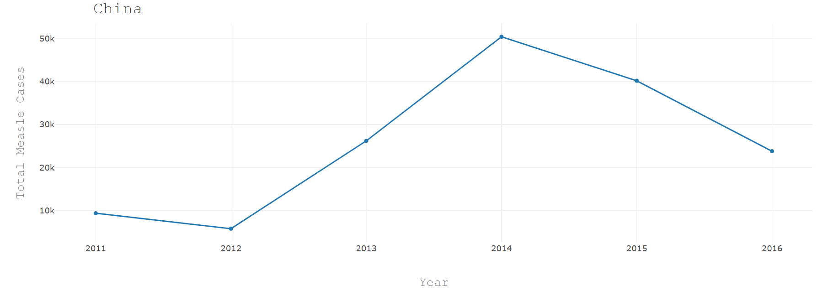
Measle Cases in China

Slide 20
INDIA
MEASLES VACCINATION RATE & NUMBER OF CASES

Slide 21
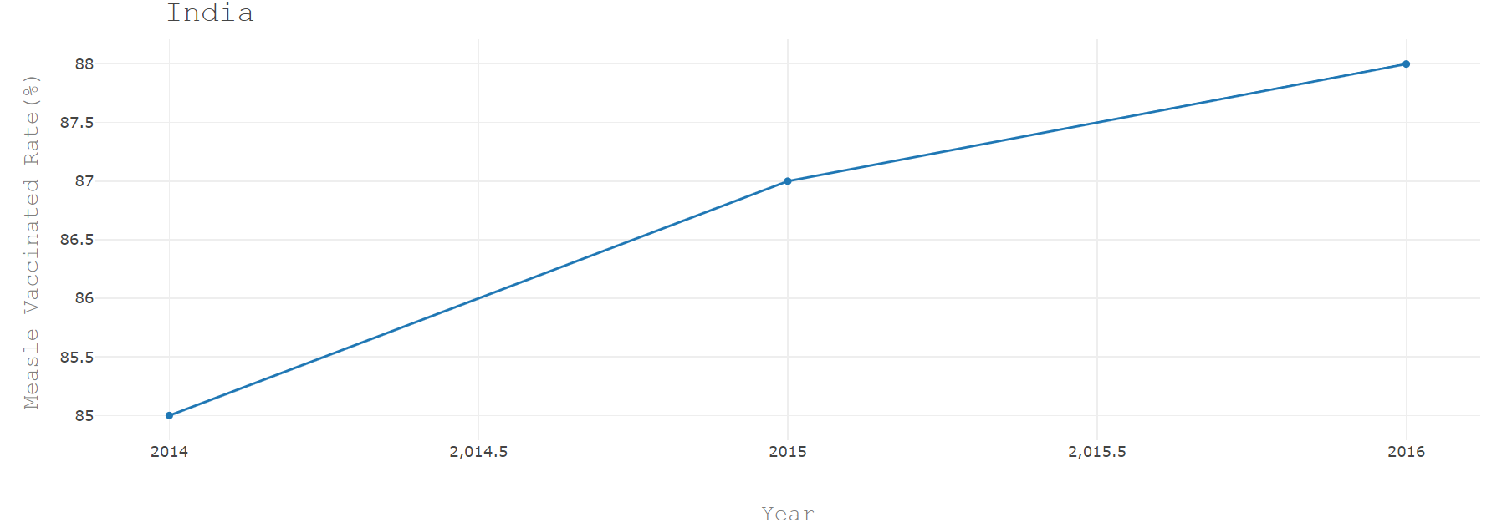
Measle Vaccinated Rate in India

Slide 22
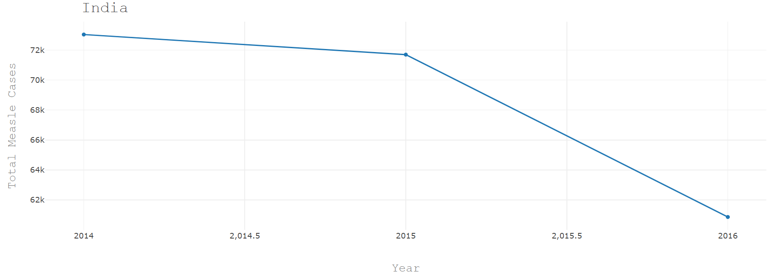
Measle Cases in India

Slide 23
POLIO DATA ANALYSIS
POLIO VACCINATION RATE & NUMBER OF CASES

Slide 24
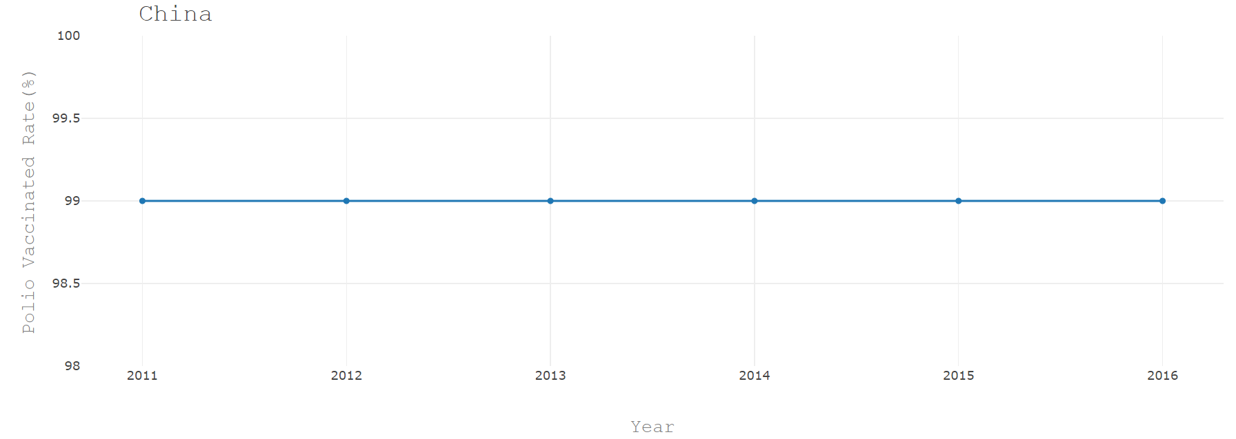
Polio Vaccinated Rate in China

Slide 25
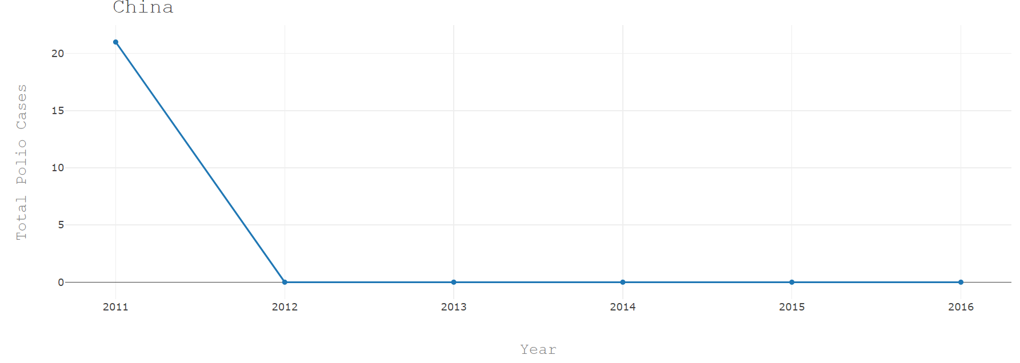
Polio Cases in China

Slide 26
Findings:
Pakistan - The reason for the rapid spread of these two diseases, Measles and Polio, include overcrowded cities, unsafe drinking water, inadequate sanitation, poor socioeconomic conditions, low health awareness and inadequate vaccination coverage. The epidemic of these diseases is also observed during conflict.
In 2017, almost one-third (nearly 36,000) of global measles deaths occurred in South East Asia, many of which were in India due to the relatively large number of unvaccinated children.
In India, the mass immunization campaigns prevented between 41,000 and 56,000 measles deaths in children (which corresponds to a reduction of 39–57%).
In Brazil, there is an ongoing measles outbreak. The risk of spread remains high due to the epidemiological situation and the high potential of transmission. The main challenges are vaccination coverage among immigrants and laboratory diagnostic capacity in local facilities
In India, the analyses revealed that the mass immunization campaigns prevented between 41,000 and 56,000 measles deaths in children (which corresponds to a reduction of 39–57%).

Slide 27
Findings:
China had its last indigenous polio case in 1994.
In 2000, the WHO Western Pacific Region declared China polio-free.
China has successfully maintained elimination of polio for over 11 years.
In July to October 2011, China experienced an outbreak caused by imported wild poliovirus type 1 from Pakistan. The outbreak affected 10 young children and 11 adults and resulted in 2 deaths.
The last polio case in this outbreak had onset of symptoms on 9 October 2011
China remains especially vigilant in efforts to maintain a polio-free status due to his neighbors Pakistan and Afghanistan.

